Slide 1
Introduction to React
By: Love Sir

Slide 2


Slide 3
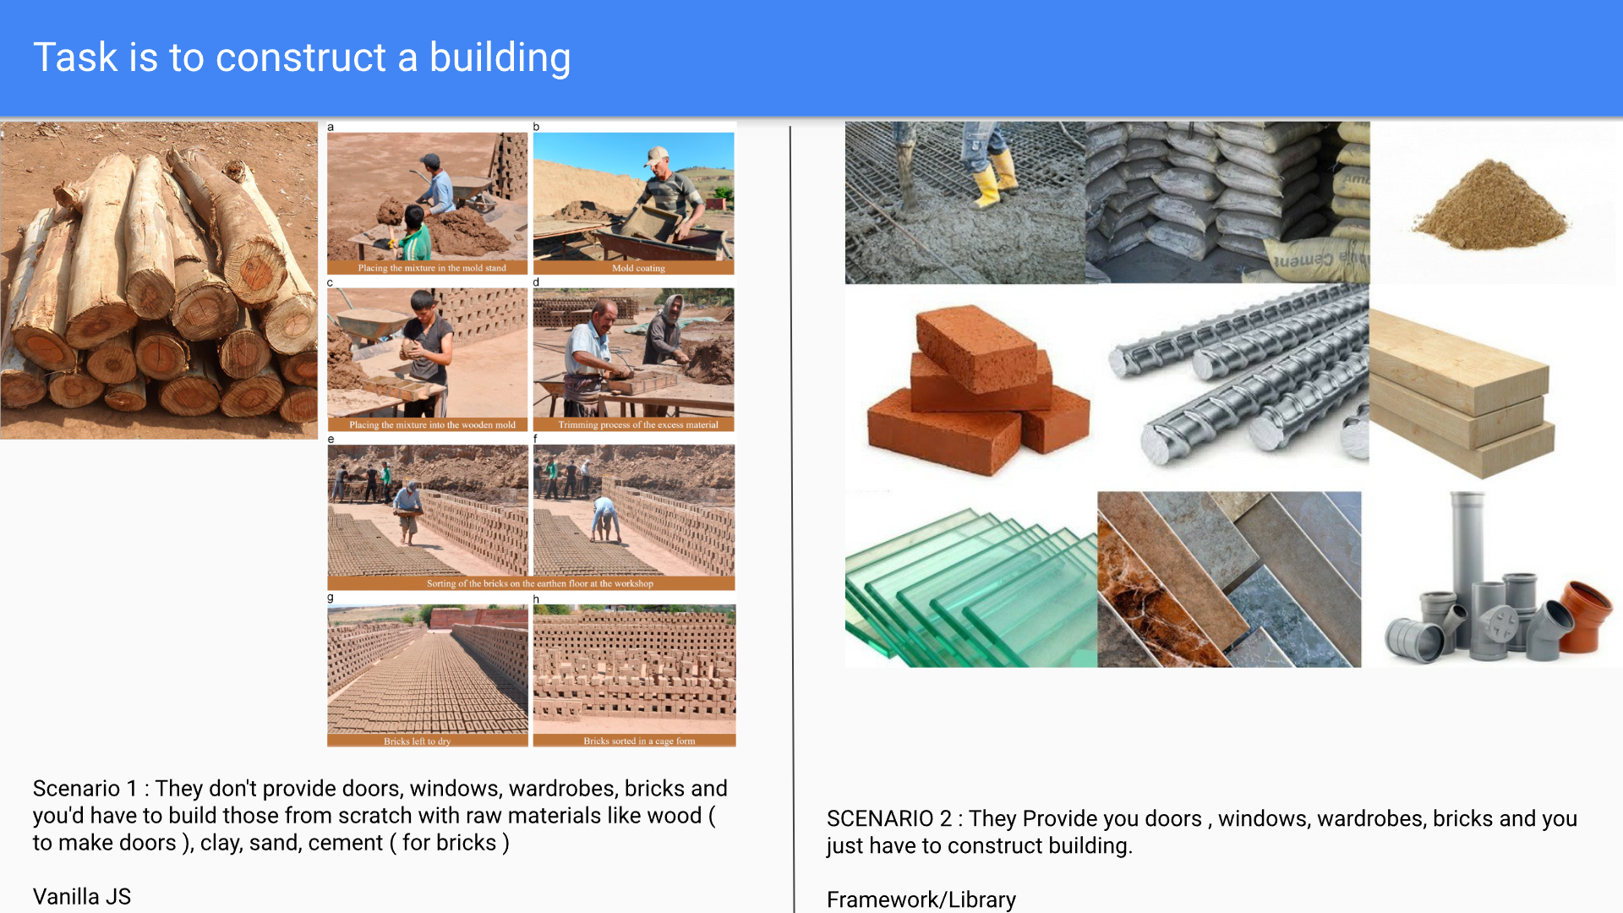

Slide 4
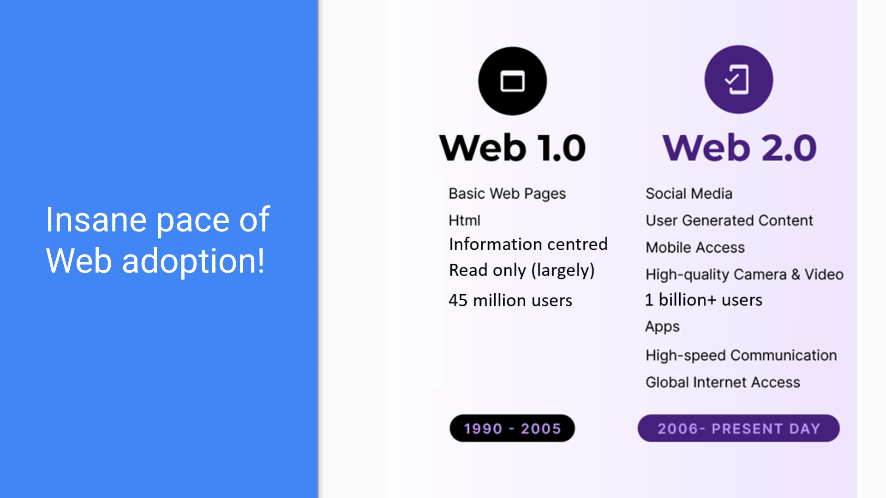

Slide 5
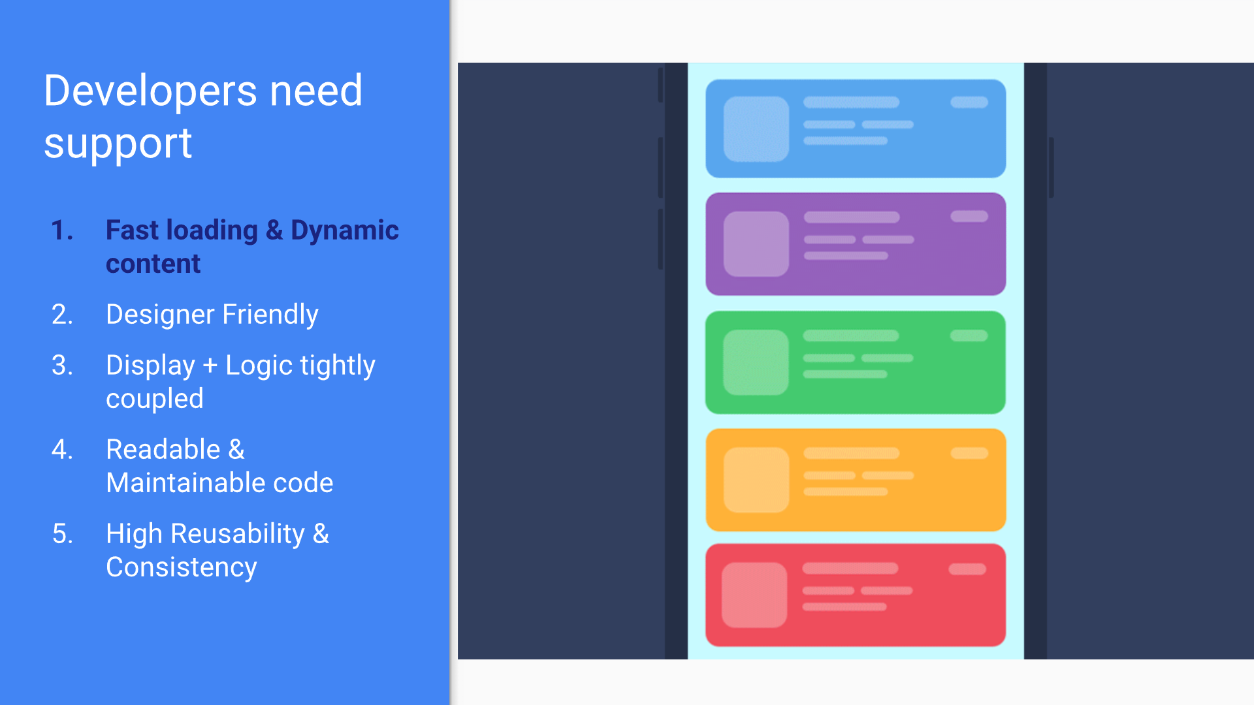

Slide 6
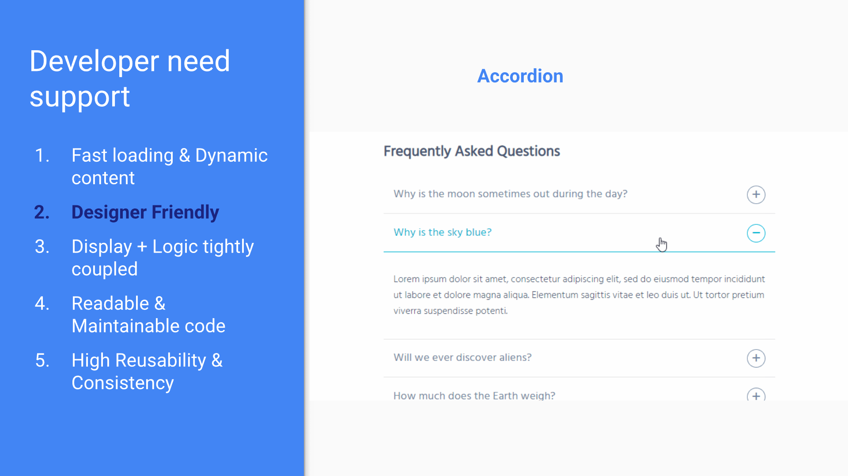

Slide 7
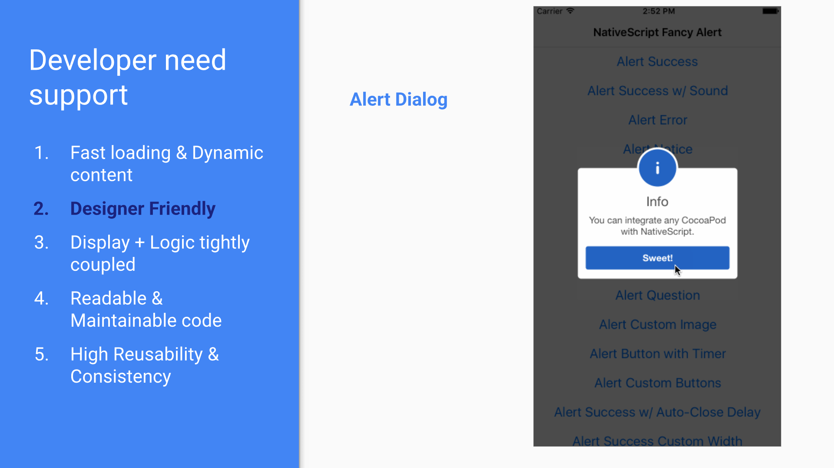

Slide 8
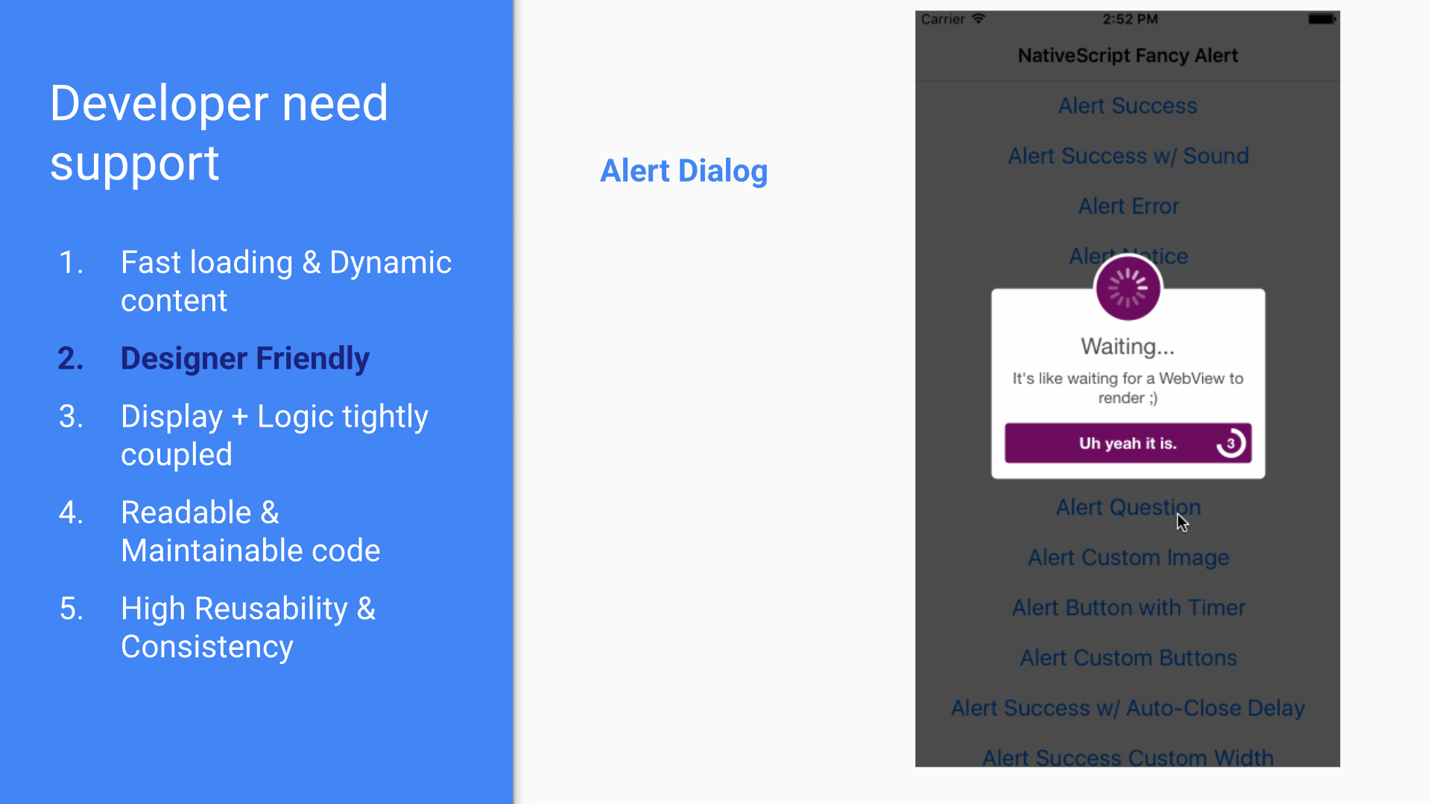

Slide 9
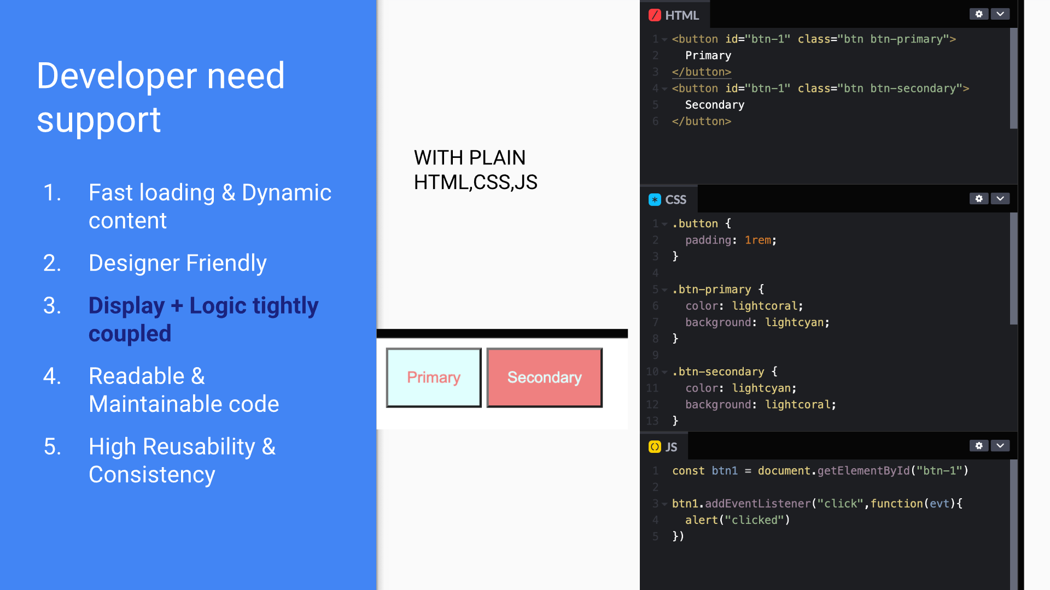

Slide 10
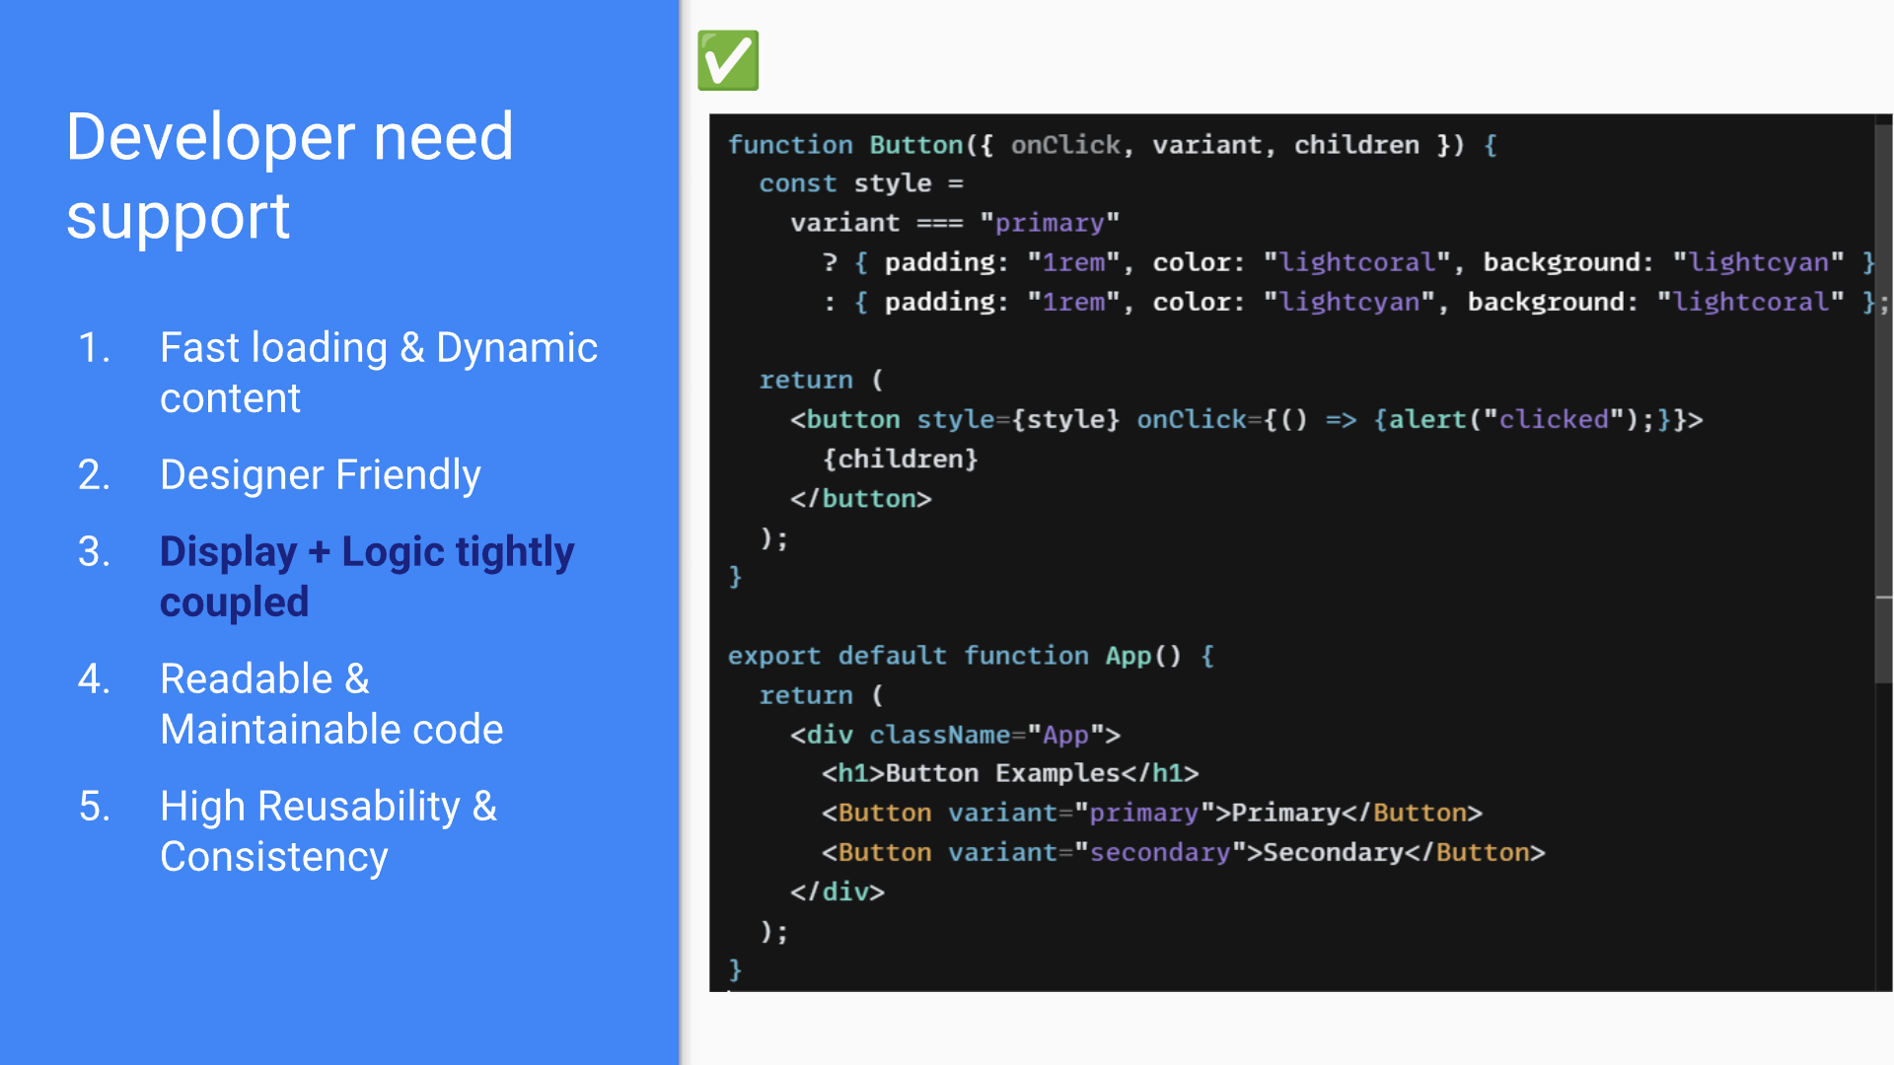

Slide 11
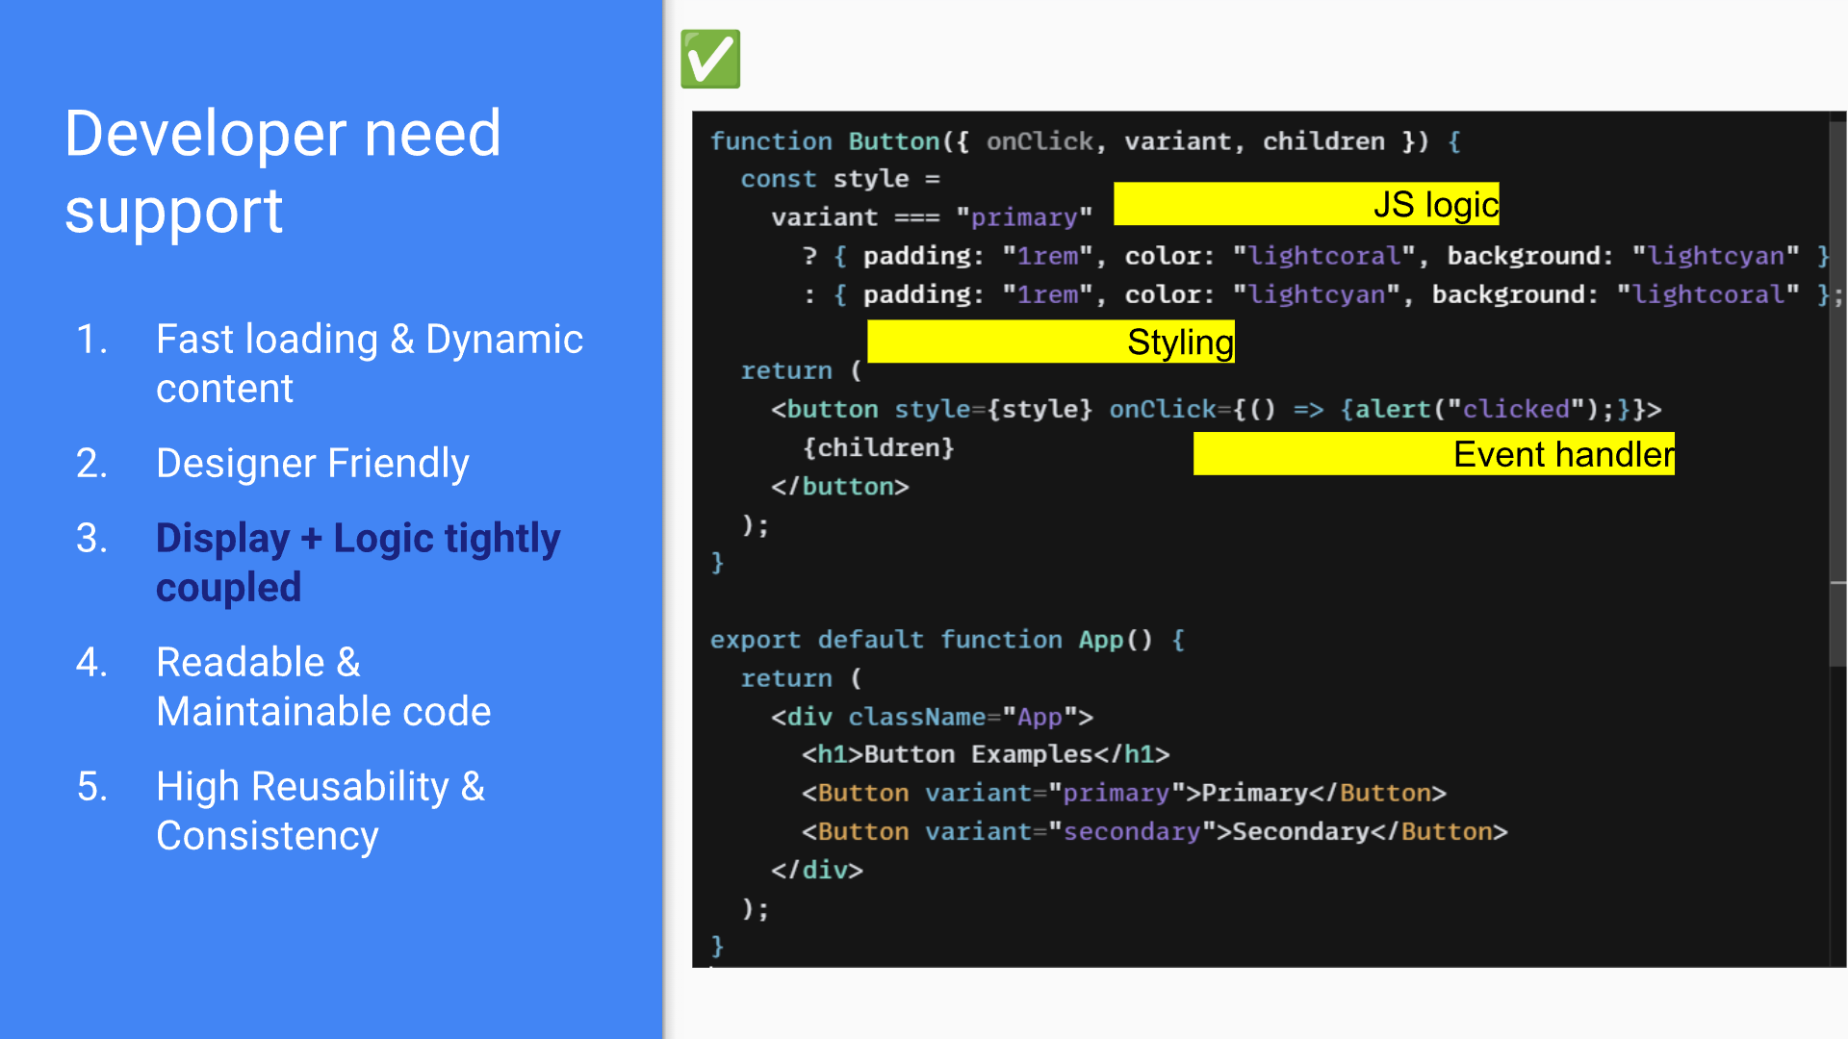

Slide 12
Activity -1: Explore/Observe the code
code sandbox Link (ReactJS code)
https://codesandbox.io/p/sandbox/student-activity-1-button-example-l5h4vq
codepen Link (Vanilla JS code)
https://codepen.io/VGUFET0412/pen/jEORbaj

Slide 13
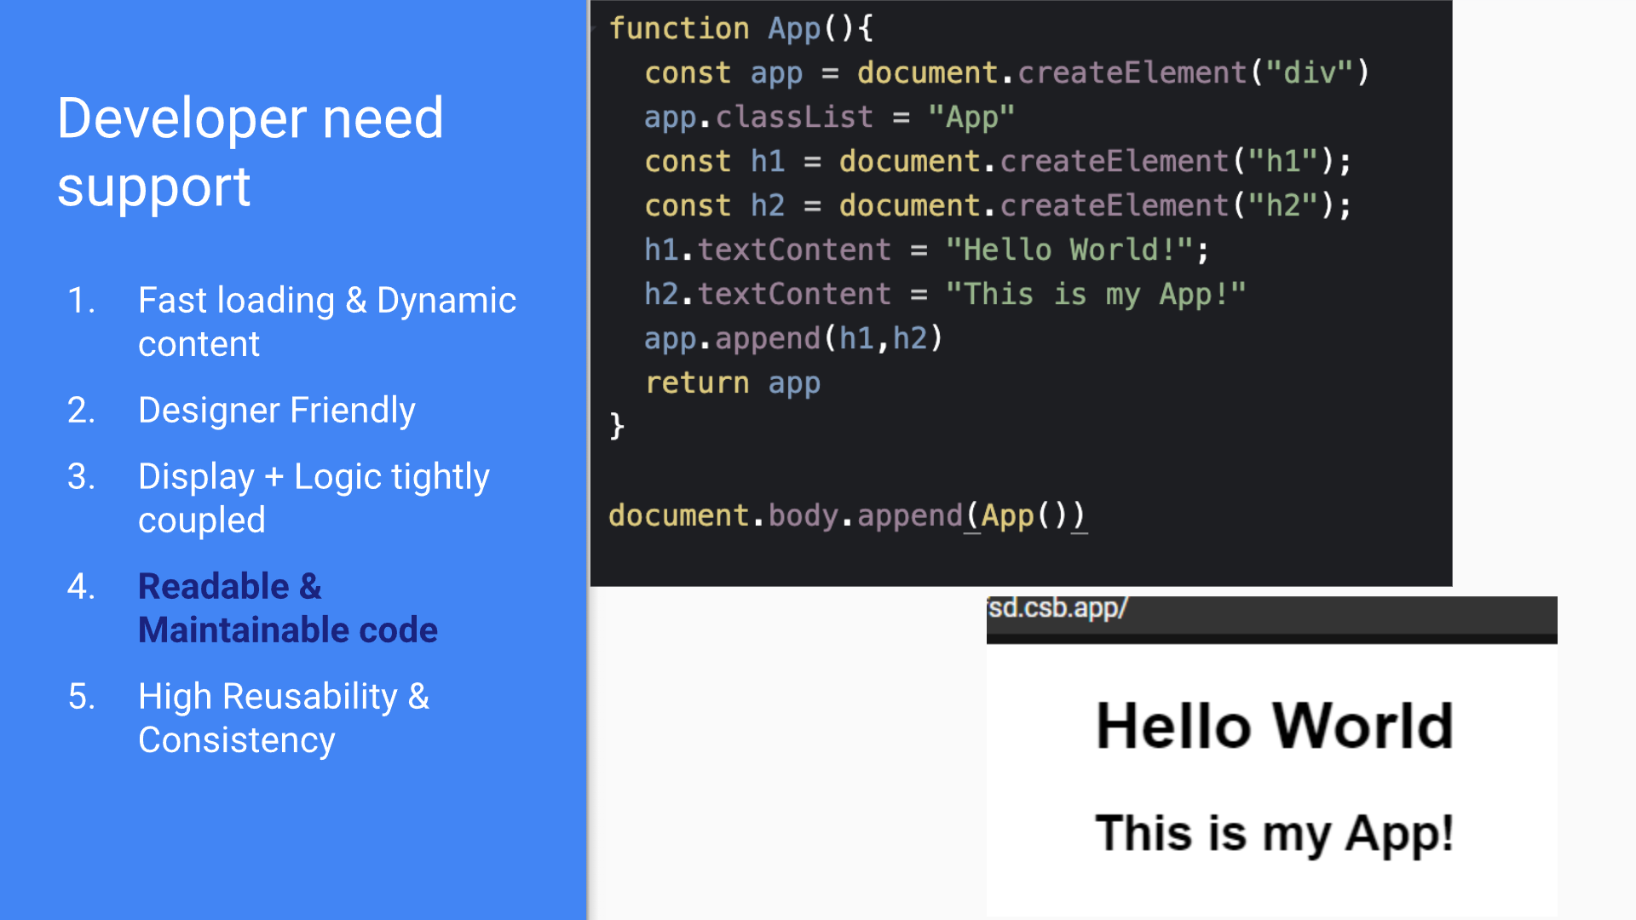

Slide 14
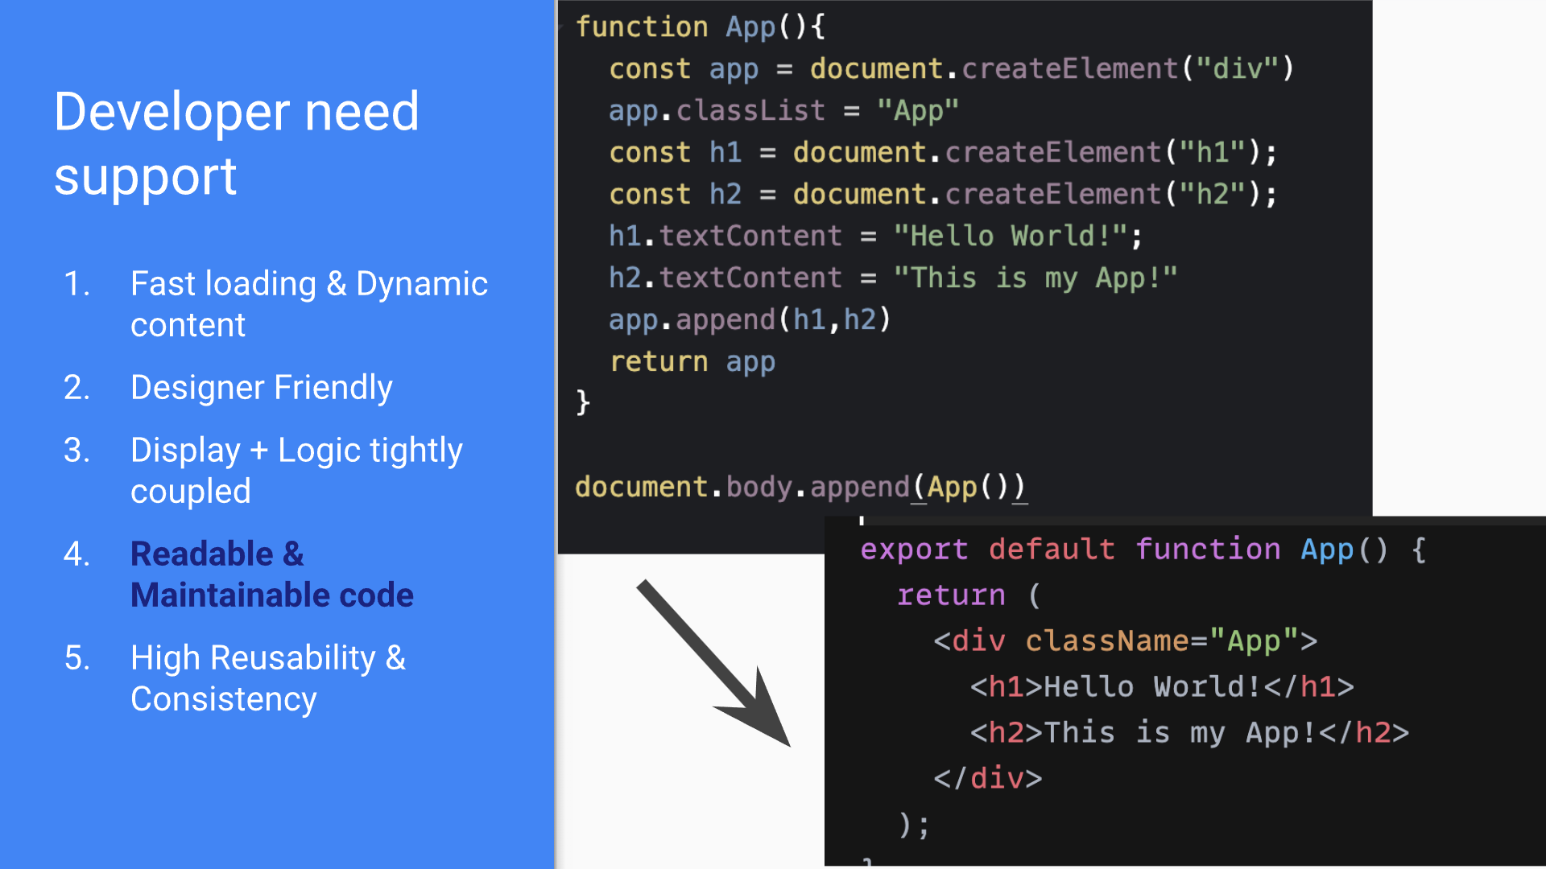

Slide 15
Activity -2: Explore/Observe the code
Code sandbox Link (ReactJS code)
https://codesandbox.io/p/devbox/readable-code-forked-rtkxg5
codepen Link (Vanilla JS code)
https://codepen.io/VGUFET0412/pen/YPzMyja

Slide 16


Slide 17
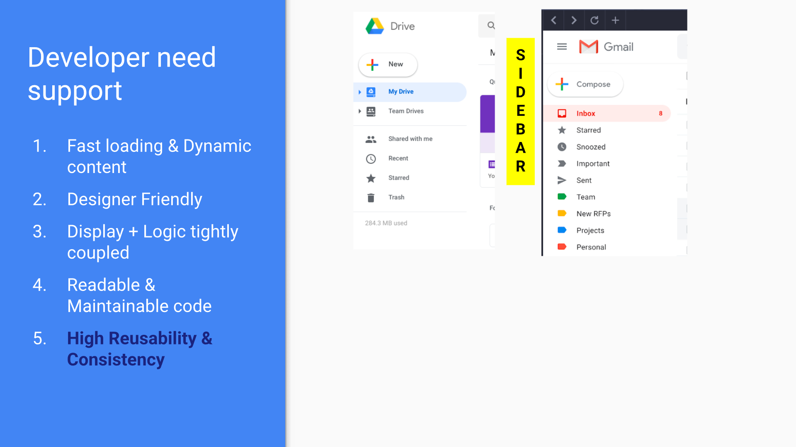

Slide 18
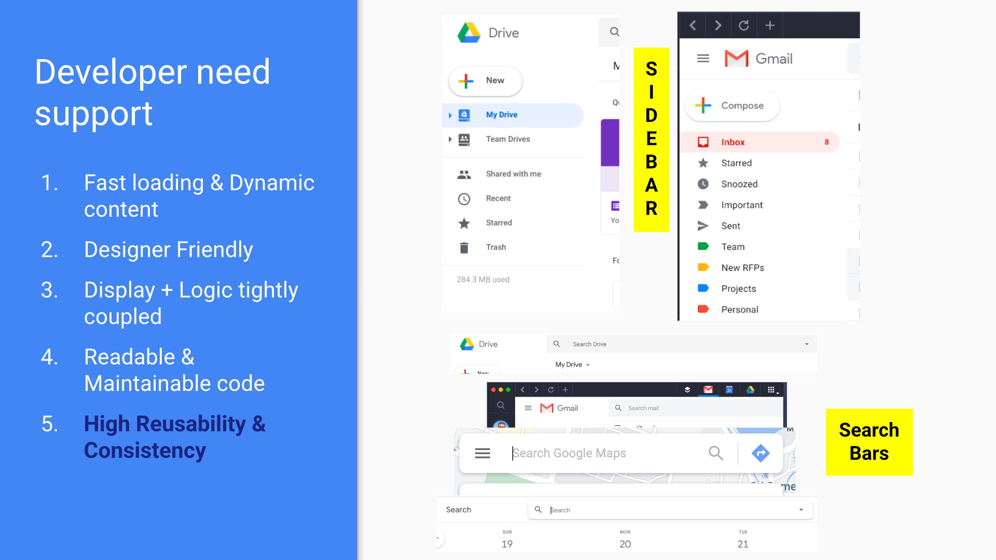

Slide 19
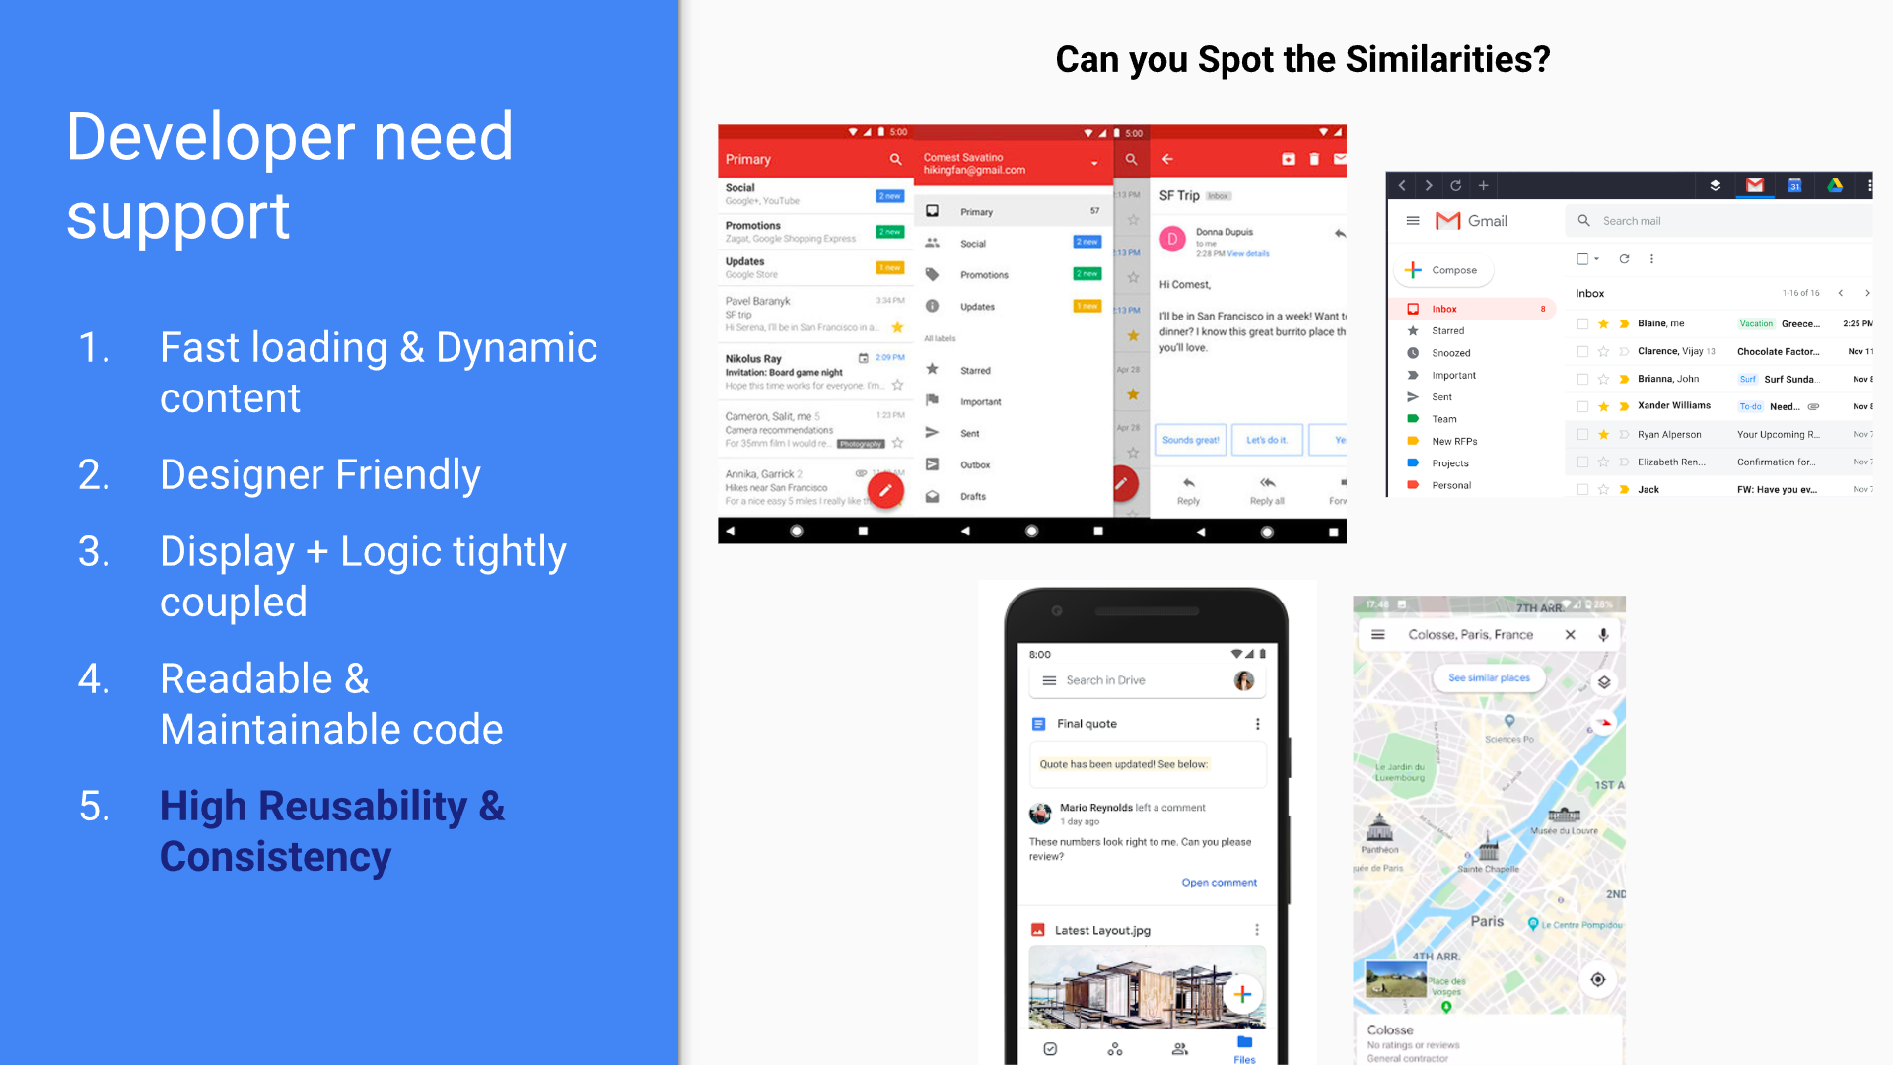

Slide 20
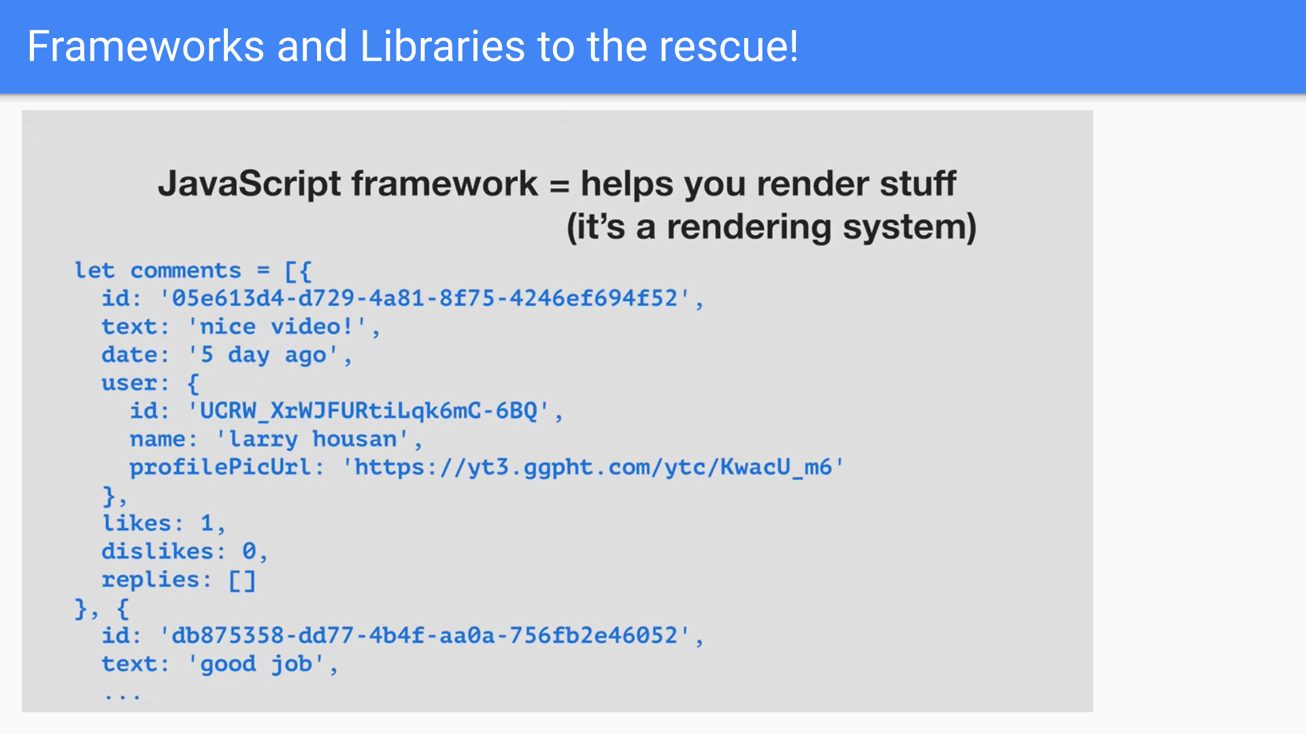

Slide 21
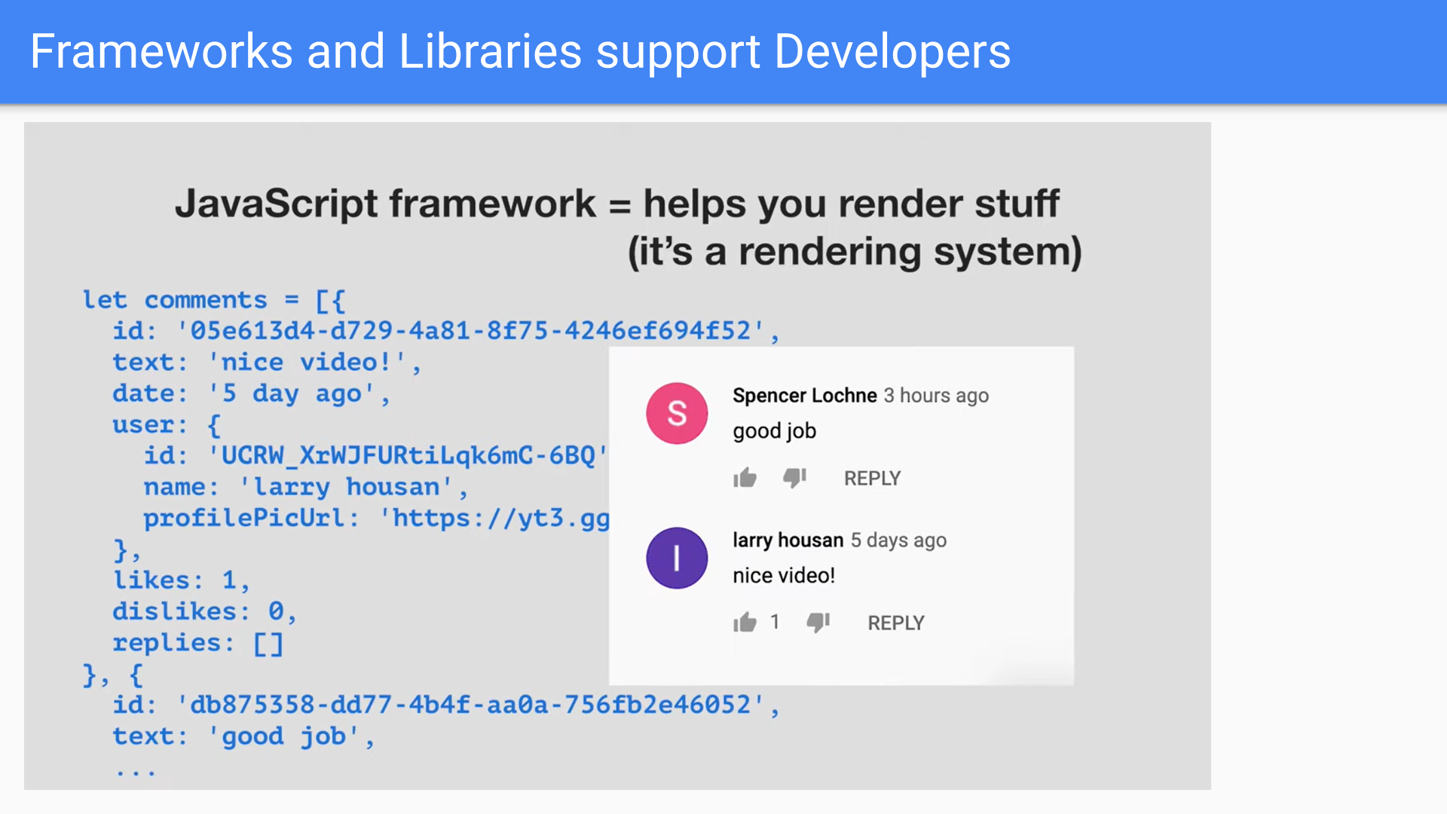

Slide 22
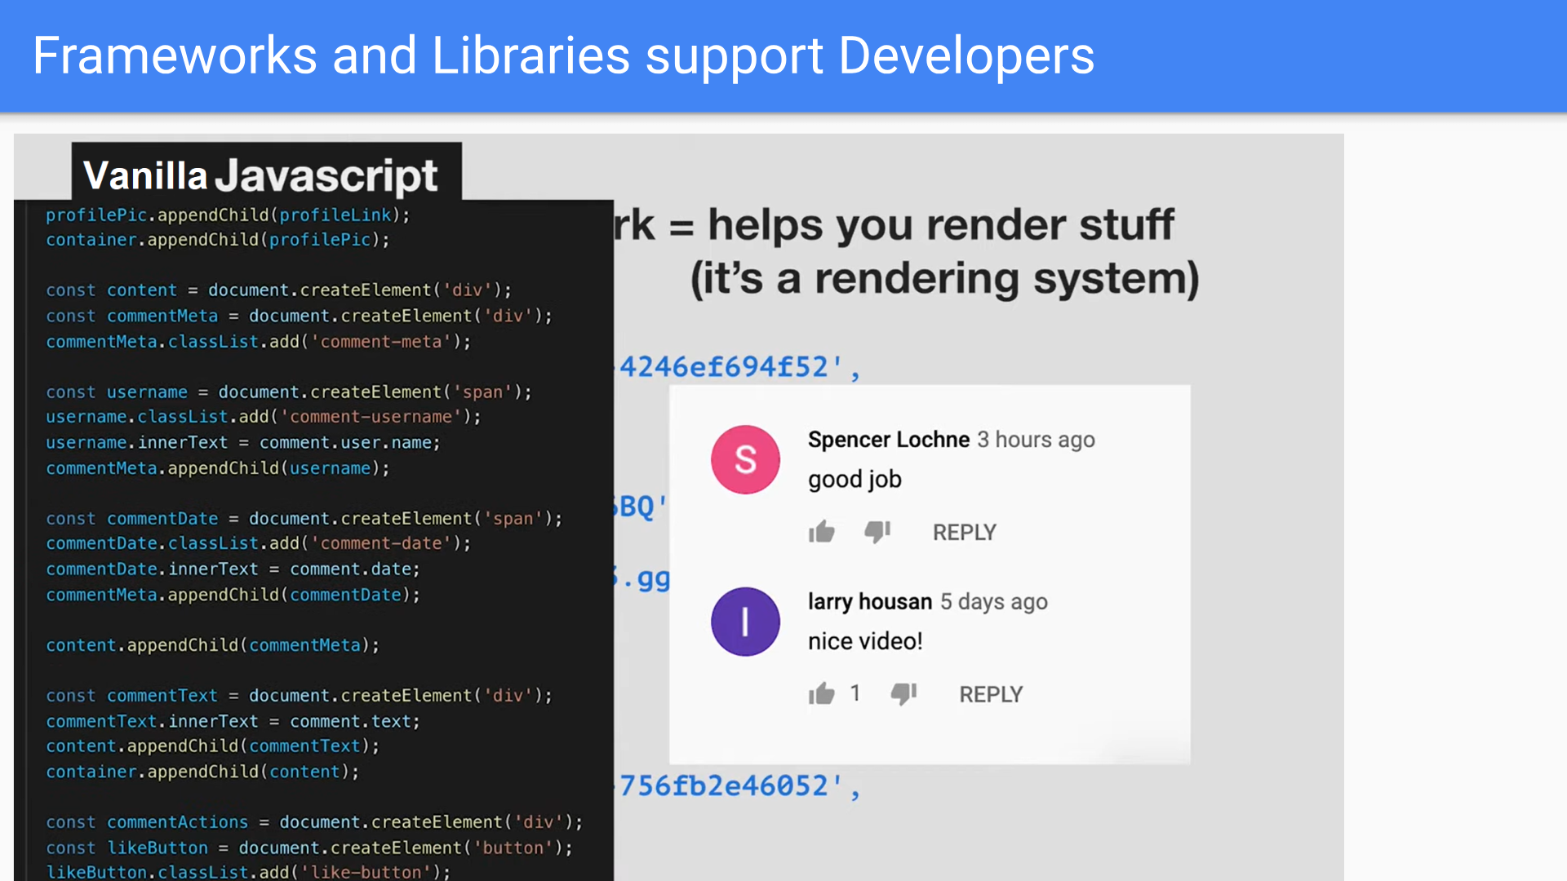

Slide 23
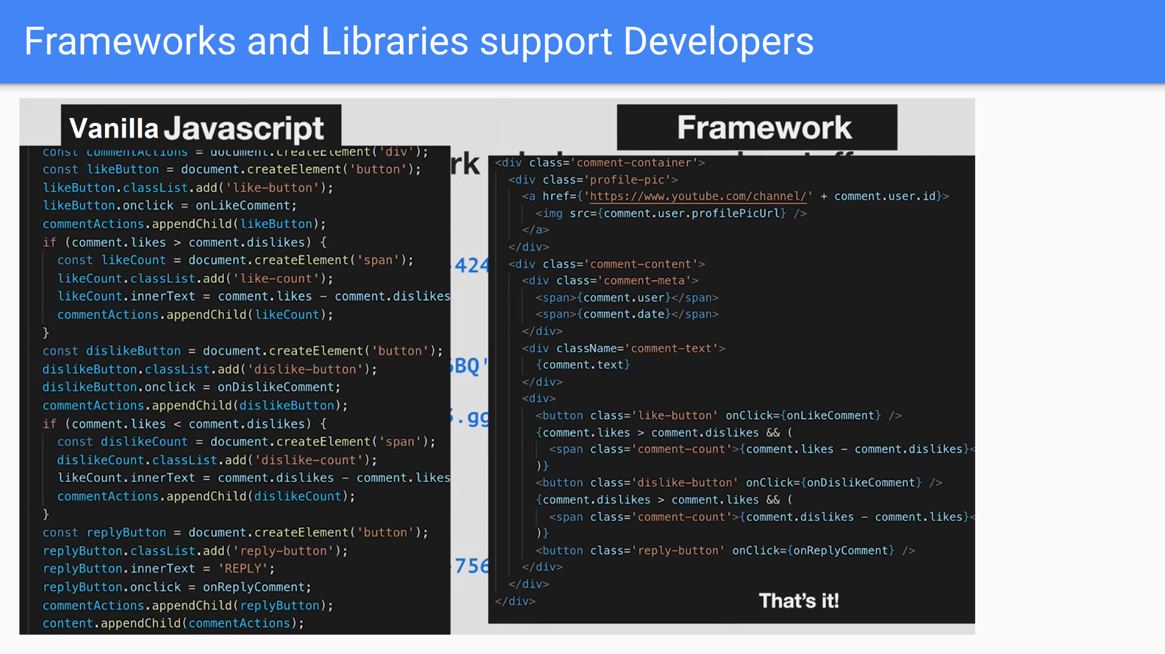

Slide 24
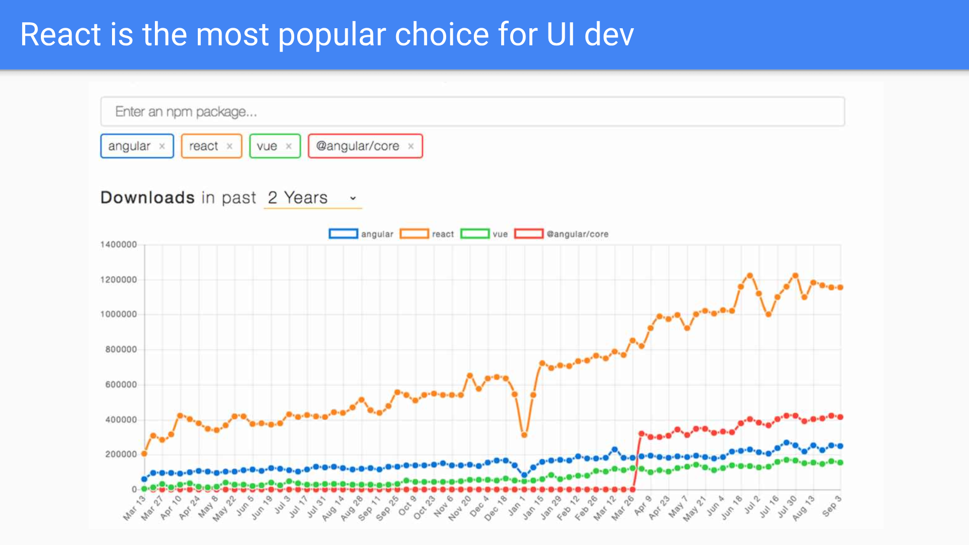

Slide 25
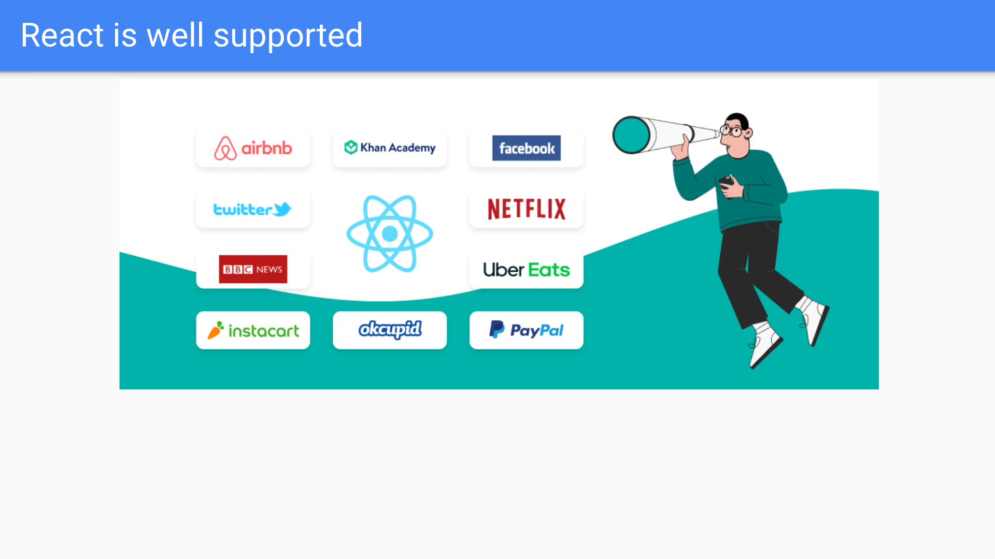

Slide 26


Slide 27
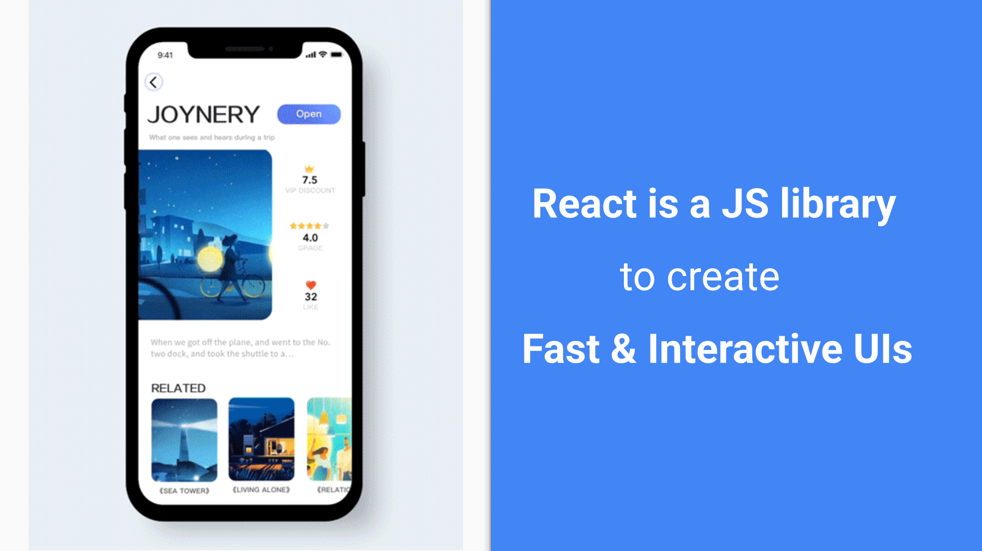

Slide 28


Slide 29
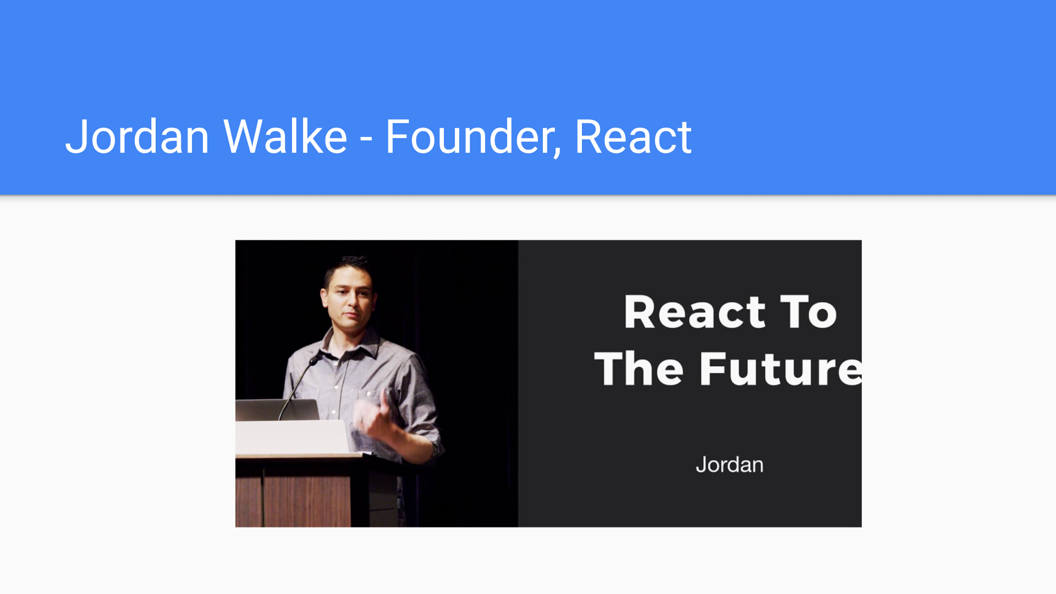

Slide 30


Slide 31
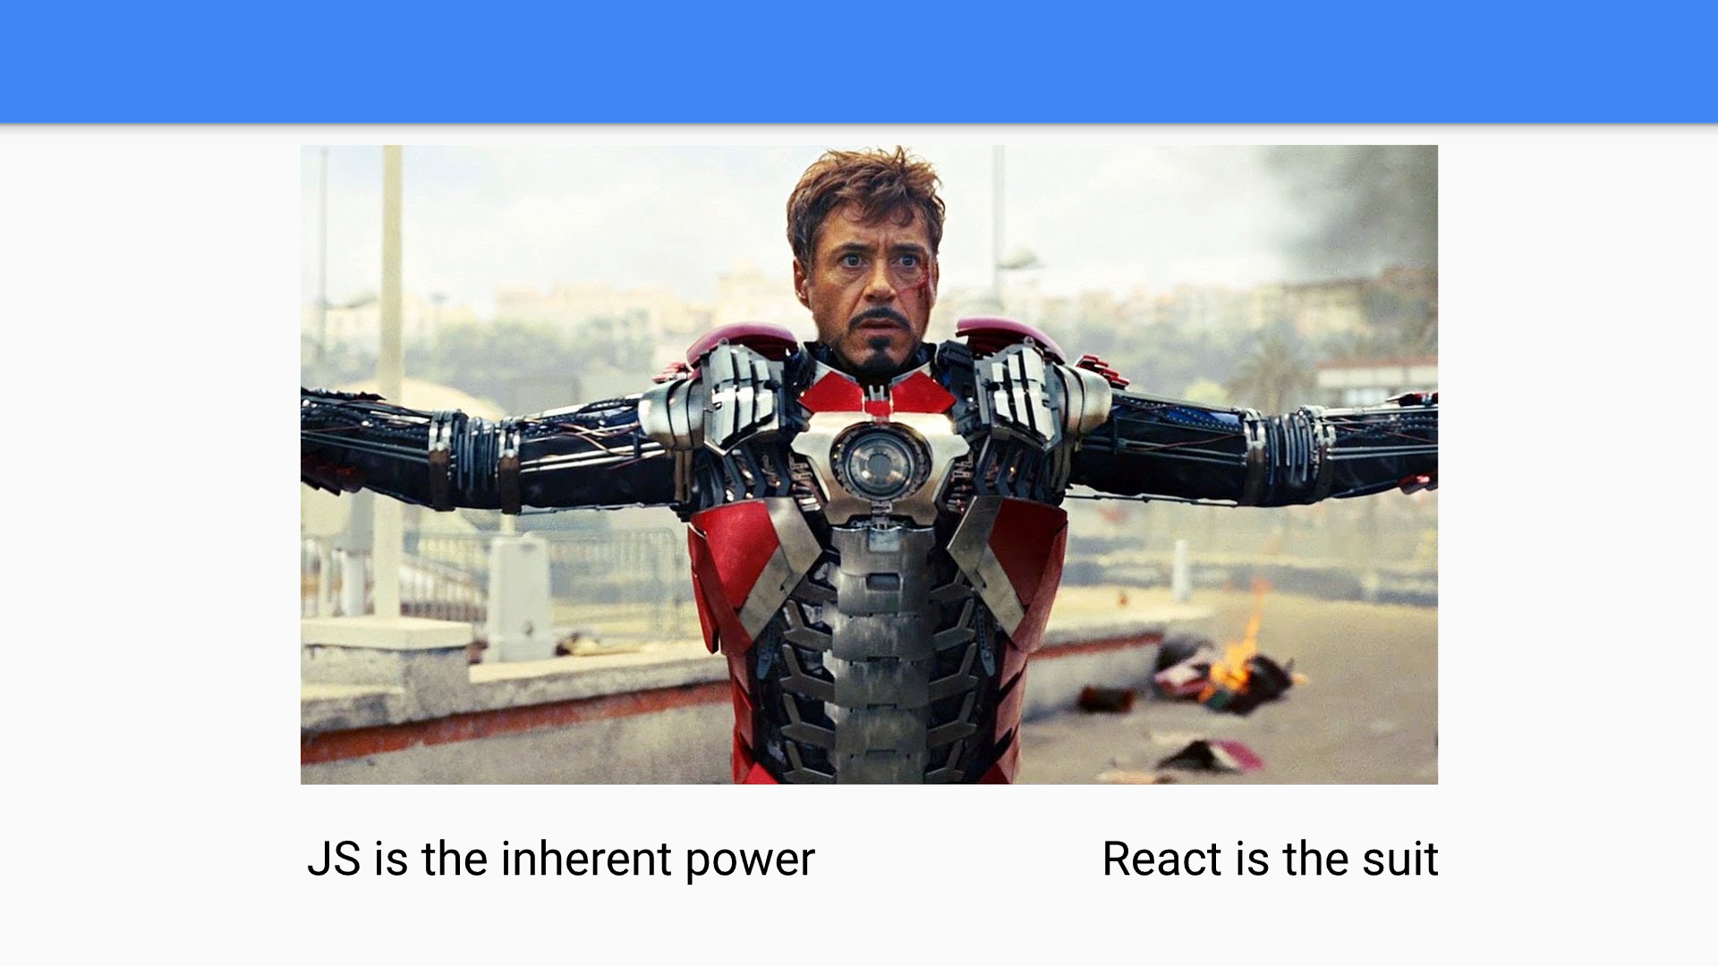

Slide 32
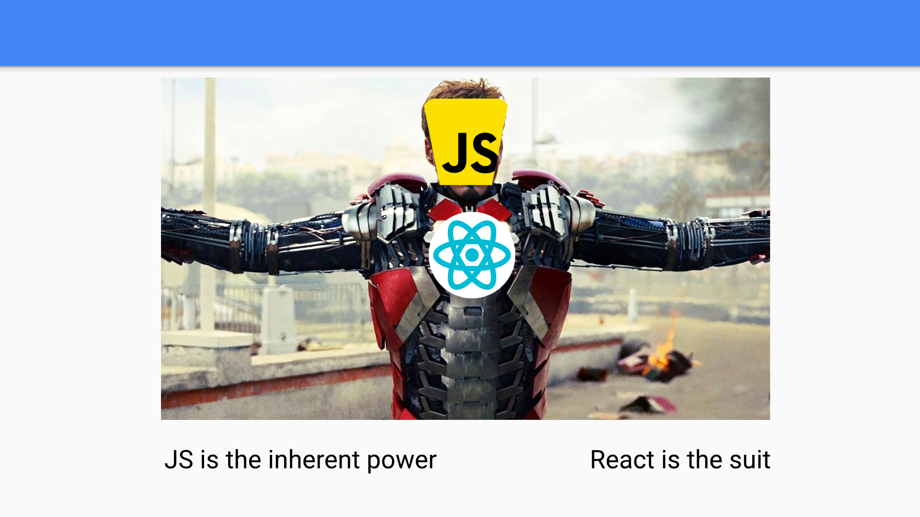

Slide 33
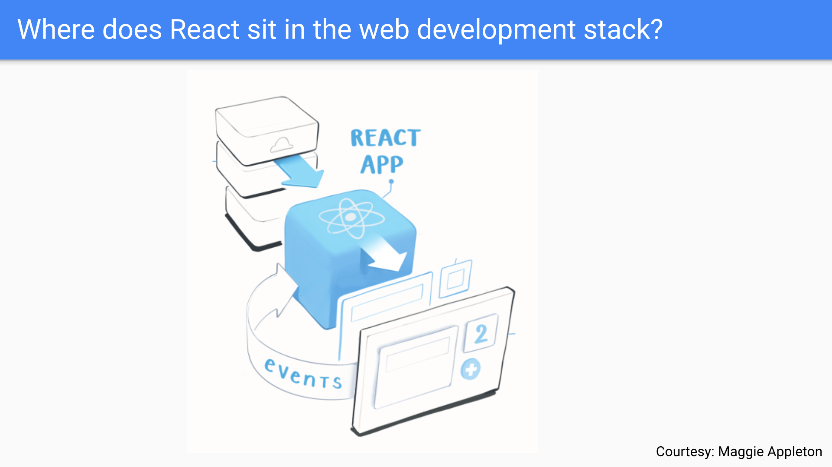

Slide 34
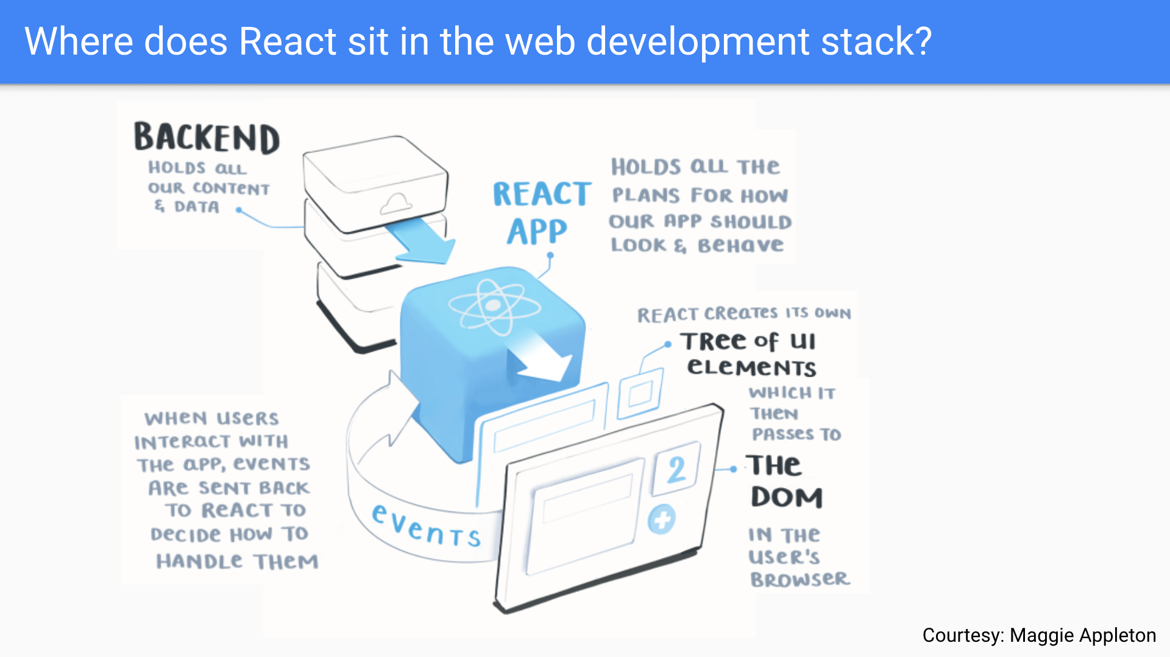

Slide 35


